Slide 1
Loops
LAU Yi Meng [G10]
Jan-2021

Slide 2
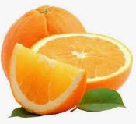
Simple For Loop
variable
condition
$i
$i < 3
0
true
1
true
<?php
for ($i=0 ; $i<3 ; $i++){
echo "Orange" . "<br/>";
?>
2
true
3
false

Slide 3
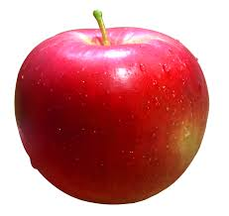
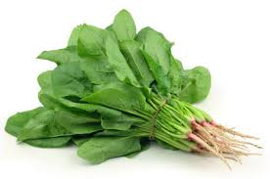
Nested For Loop
<?php
for ($i=0 ; $i<3 ; $i++){
echo "Apple" . "<br/>";
for ($k=0; $k<2; $k++){
echo "Spinach" . "<br/>";
}
}
?>

Slide 4
While Loop
$apple
<?php
$apple=1;
while ($apple < 4){
echo "Apple" . "<br/>";
$apple ++;
}
?>
1
2
3
4
($apple < 4)
true
true
true
false

Slide 5
do … while Loop
$apple
<?php
$apple=1;
do {
echo "Apple" . "<br/>";
$apple ++;
} while ($apple < 4)
?>
1
2
3
4
($apple < 4)
true
true
false

Slide 6
Nested While Loop
$orange
1
2
<?php
$orange=1;
while ($orange < 3){
echo "orange" . "<br/>";
$apple=1;
while ($apple <= 2){
echo "apple" . "<br/>";
$apple++;
}
$orange++; }
?>
3
$apple
1
1
2
2
3
3

Slide 7
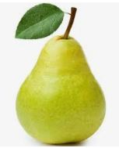
foreach Loop
<?php
$fruits = ["apple", "orange", "pear"];
foreach ($fruits as $item){
echo $item ;
}
?>

Slide 8
Arrays

Slide 9
Associative Array
=> 2
<?php
$fruits = ["apple" => 2,
"orange" => 1,
"pear" => 3];
foreach ($fruits as $key => $value){
echo $key ;
echo " => " . $value . "<br/>";
}
?>
=> 1
=> 3

Slide 10
Nested Arrays
<?php
$new_arr = [
"vehicle" => ["bus","train","mrt"],
"grocery" => ["milk","bread"],
"animal" => ["lion","tiger","penguin","elephant"]
];
foreach ($new_arr as $key => $items){
echo $key . "<br/>";
$arrLen = count($items);
for ($i=0; $i<$arrLen; $i++){
echo $items[$i] . " ";
}
echo "<br/>"; }
?>
Displayed on Web Browser
vehicle
bus
train
mrt
grocery
milk
bread
animal
lion
tiger
penguin
elephant

Slide 11



Indexed Array
$fruits =
[
[
,
,
,
]
]
<?php
$fruits = ["apple", "orange"];
$fruits[1] = "pear";
$fruits[] = "strawberry";
var_dump($fruits);
?>
[
,
]

Slide 12



Associative Array
$hongbao=
[
,
=>
2
<?php
/* My mother gives me two hongbaos with each $2 */
$hongbao = [ "citibank" => 2,
"uob" => 2 ];
/* I receive a citibank HongBao from my Aunt #1 - $60 */
$hongbao["citibank"] = $hongbao["citibank"] + 60;
/* I receive an ocbc HongBao from Uncle #2 - $60 */
$hongbao["ocbc"] = 60;
/* I take out uob hongbao $2 to buy McDonald's mango pie */
$hongbao["uob"] = 0;
var_dump($hongbao);
?>
[
[
,
[
,
,
=>
62
=>
62
=>
62
=>
]
2
,
,
=>
]
=>
2
=>
2
0
=>
60
]
=>
60
]
Notes:
https://www.ocbc.com/group/group-home.html
https://www.uobgroup.com/uobgroup/default.page
https://online.citi.com/US/login.do

